Slide 1
Design, Develop, Implement, Test & Document Used Car Sales Portal Website
Module Project
Module: Application Development & Process
Start Date : 04 April 2023
End Date : 06 Mei 2023
Submission Date :07/05/2023
Learner Name : Ajri Muhammad siddik
Enrollment ID : bdse0922
Presentation Date :

Slide 2
Contents
Document History
Version Number | Effective Date of release | Summary of Included Changes | Author

Slide 3
Contents
Contents
S. No. | Description
01 | List of software used
02 | Business Process
03 | Project Plan
04 | Stages of Risk Based Testing models
05 | Types of risks
06 | Risk Based Testing Strategies
07 | Qualitative and Quantitative Risk Analysis
08 | Security Testing
09 | Test plans and Test cases
10 | Logs of Test Results
11 | Modifications of fail Test Cases
12 | Effectiveness of RBT strategy
13 | Project Results

Slide 4




1. List of software used
Word
Mysql
Chrome
Tools & platform used Spring tools suite

Slide 5
2. Business Process
<algorithm/flow of the business process>
Scenario 1 - post Car
Enter the URL http://localhost:8080 to access the used website ABC cars PTE Ltd (cars sales)
Click sign up “if you do not have account “ and field name, username, Email, password. As new user
User will see the register success message with link to login page
Enter register username and password in the login page
User will then see the home page with the list of sell cars posted by other user
Click ‘sell car now’ in home page to post and enter car name, model, Price(RM),Make year, Registration Date and Photo then click on post
User will see a post success message with link to the car detail page
Scenario 2 – Edit Profile
Enter the URL http://localhost:8080 to access the used website ABC cars PTE Ltd (cars sales)
Click sign up “if you do not have account “ and field name, username, Email, password. As new user
User will see the register success message with link to login page
Enter register username and password in the login page
User will see the home page and user can click profile in navbar
And user can see the profile page. Then user click edit profile to update name, username, Email. And can add mobile and address.
And click update and user can see the profile that has been changed

Slide 6
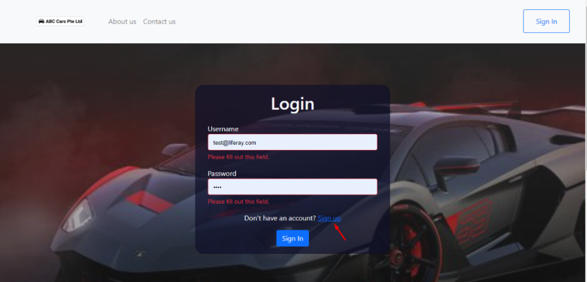
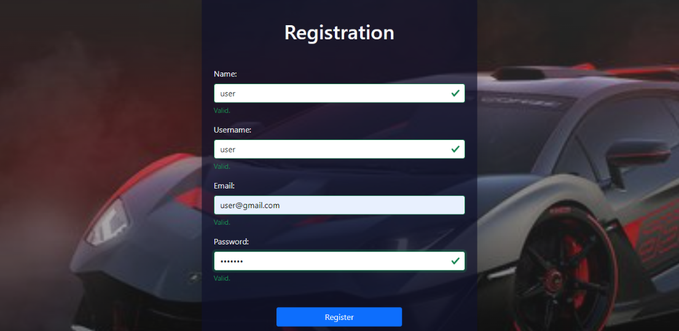
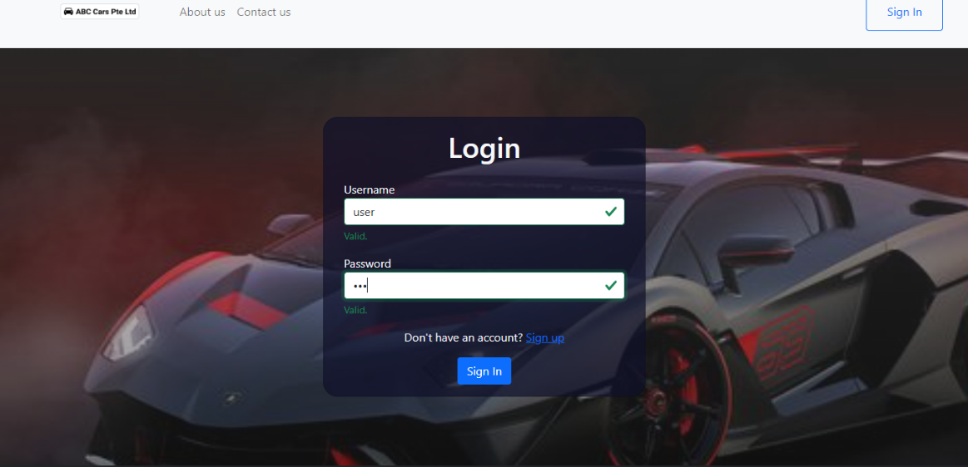
Post car
UI screenshot
i. Scenario – Post Car

Slide 7
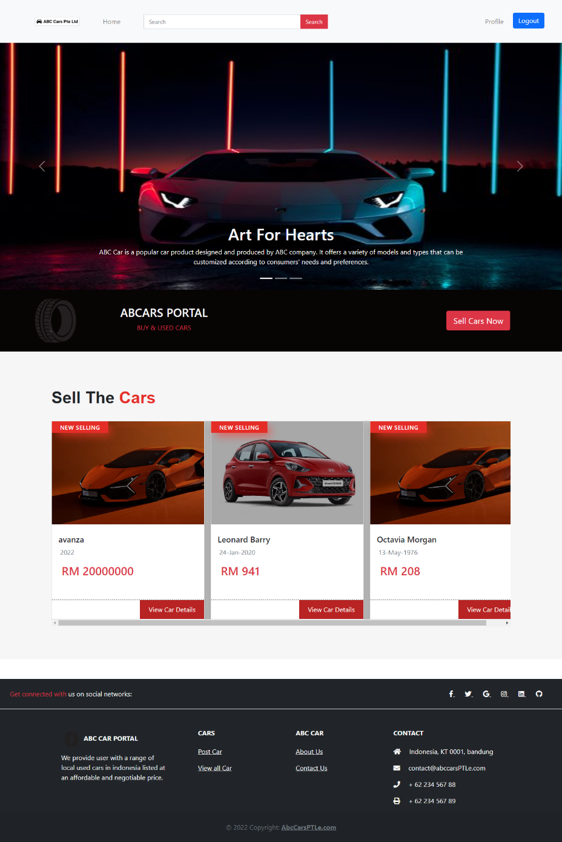
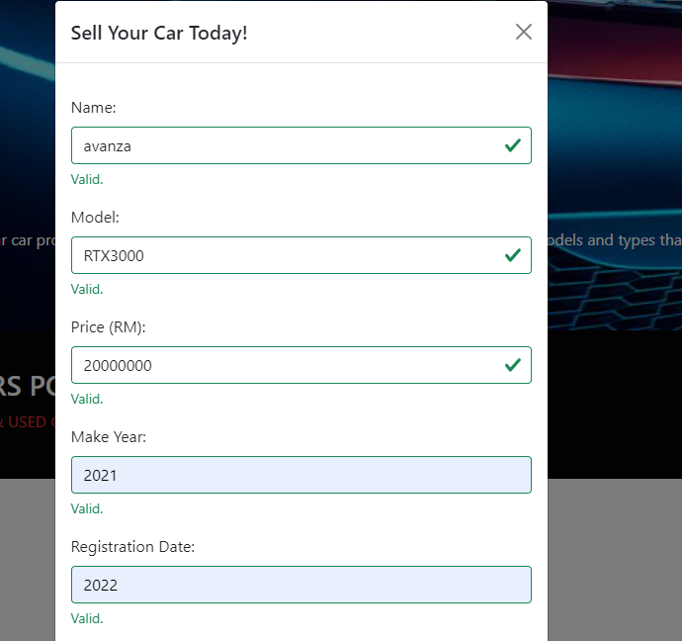
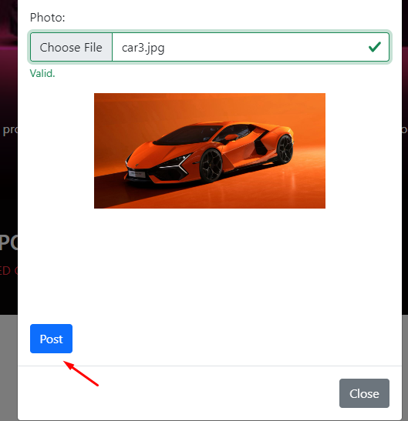
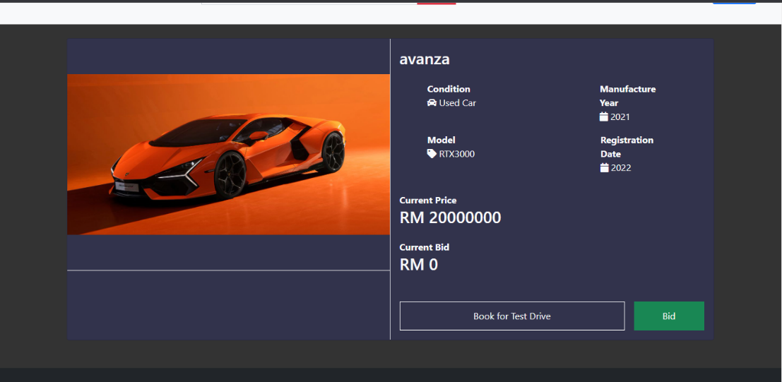
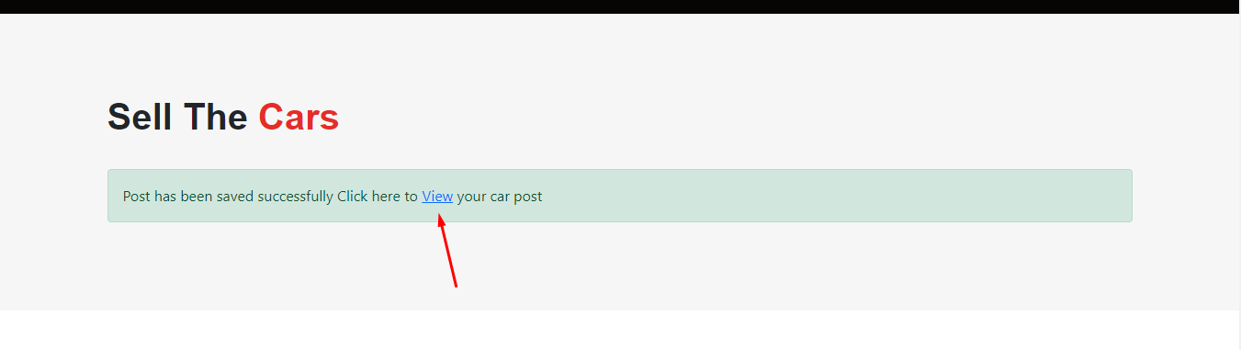
Post car

Slide 8

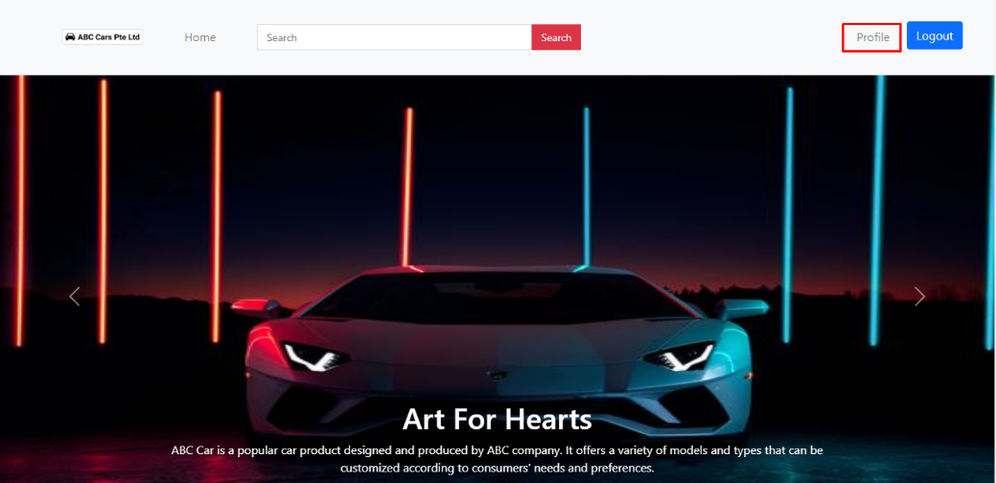
Edit profile
Scenario – edit profile Scenario

Slide 9
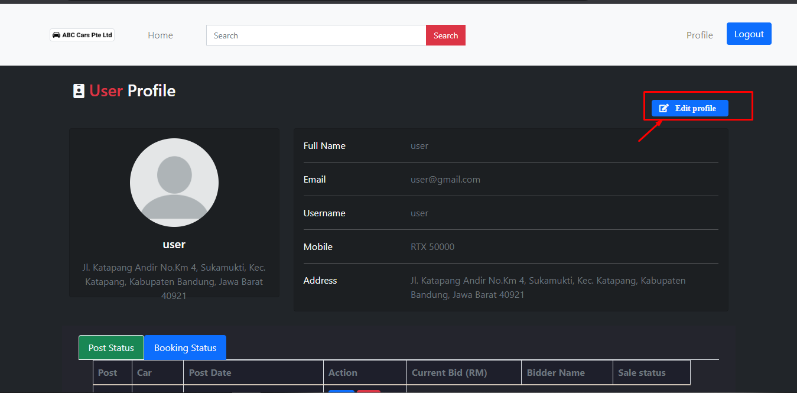
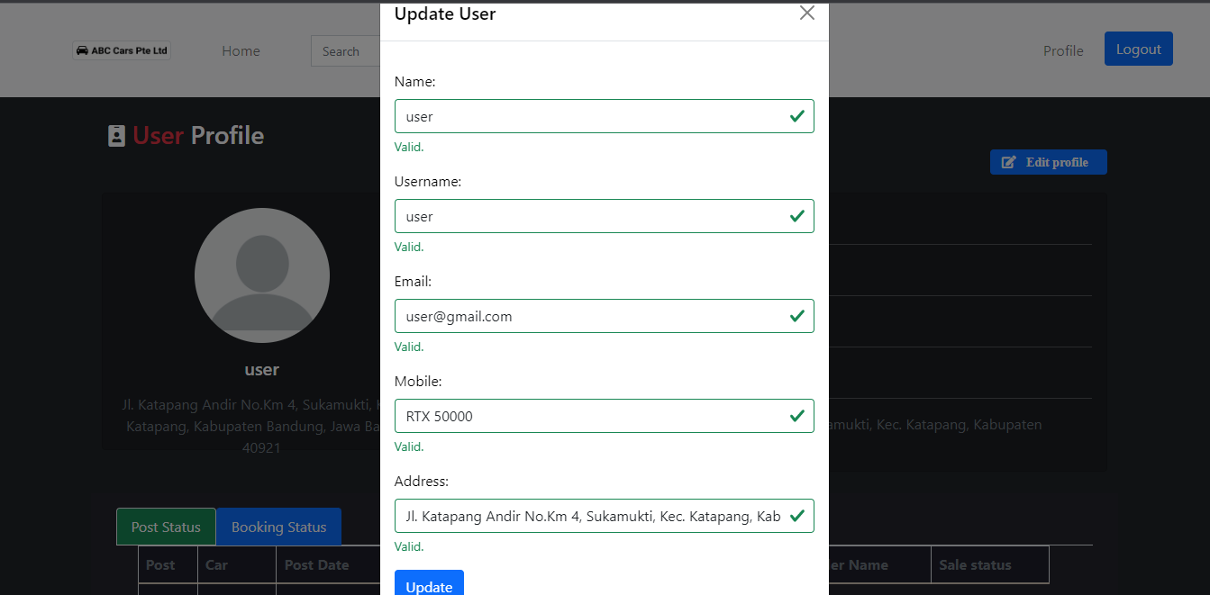
Edit profile

Slide 10
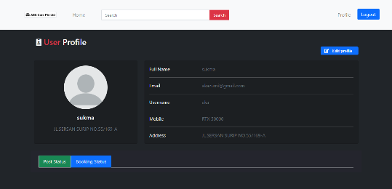
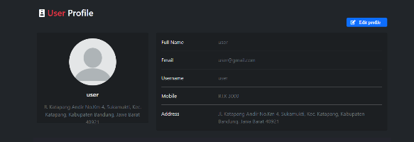
Edit profile
Before
After

Slide 11
Functionality
Functionality
Pages | Functionality
Registration | To registration a new user to the Car PT LTD website by obtaining a username, email and password
Login | To validate user registered credentials, username and password before user can access the website car sales home page
Home | Page seen by user after successful login containing the list of all car posted and post a car sale form
Car Detail | Users are able to view comprehensive information about a car either by posting it for sale or by clicking on the "View Car Detail" button from a filtered list of cars available on the homepage or search results
Search Result | The page that appears to the user after performing a search for a particular make, model, registration or price using the search bar located in the header displays a list of cars that match the search keywords

Slide 12
functional
Update Profile | Users are permitted to change their profile details, like their mobile number and address. Additionally, they have the option to monitor the status of their car sale postings and bookings or delete
User management | To allow the administrator to view a list of registered users, mark a user as administrator or update their profile or delete the user
Car Management | To allow the administrator to view a list of cars posted, dele car posts, update status for user booking based on bidding or updating status for car sale
About us | The page viewed by the user contains a description of the car seles website
Contact us | The page viewed by the user contains his feedback and can see the location of the store

Slide 13
3. Project Plan

Slide 14
4. Stages of Risk Based Testing model
Risk identifying | Risk Impact Analysis | Risk Mitigating | Risk Monitoring
Risk can be identified in a variety of ways, including: -Brainstorming Alternately, the risk can be separated into three categories, including: • Functional risk, a known risk Technical risk and non-functional risk • Unknown risk may surface when testing: - Insufficient resources - Testing was delayed because a fault appeared suddenly. Unpredicted and having a major impact, unknown danger - System outage lasting longer than a day Natural disasters | The risk matrix can be used by project managers to assess a risk's likelihood of happening and its impact on the project. By assigning each risk a rating on a scale, project managers may determine which dangers need the most attention. It's a tactic to ensure that risks are identified and dealt with methodically and effectively.Unpredicted and having a major impact, unknown danger- System outage lasting longer than a day - Natural disasters | After risks have been identified and assessed, a response strategy to handle them must be created. The reaction strategy can either involve eliminating the threat or reducing its effects to a reasonable level. The reduction of risk is what is referred to as risk management in the context of software development. | Monitoring and managing risks means keeping an eye out for any that might still be there as well as identifying any fresh ones that might emerge as the project moves forward. To monitor and manage risk, the team can use strategies including auditing, trend analysis, risk reassessment, and project status updates.

Slide 15
5. Types of risks
Types of Risk

Slide 16
6. Risk Based Testing Strategies
Risk Id | Test Scenario ID | Test Scenario | Test Objective | Test Priority | Risk | Technique | Expected Results
1 | UA001 | Ensure user can register in the portal | To allow user to register with their credentials (name, username, email, password) successfully | High | User is not able to register with their credentials | UAT Testing | After registering user will see the succes message and their credentials saved in the database
2 | UA002 | Ensure user can login in the portal | To allow user to login with registered credentials | High | User is not able to log in with registered credentials | UAT Testing | After login, user will reach to the home page
3 | UA003 | Ensure user car post a car in the portal | To allow user to post a car in the portal | High | User is not able to post a car in the portal | UAT Testing | Users can post their car in the portal
4 | UA004 | Ensure user can search and view car detail | To allow user to search a particular car in the portal | High | User is not able to find the expected car | UAT Testing | After giving the keyword user will see matched search result
5 | UA005 | Ensure user can update his profile | To allow user to update their profile | High | Users is not able to update their profile | UAT Testing | Users can see updated details in their profile

Slide 17
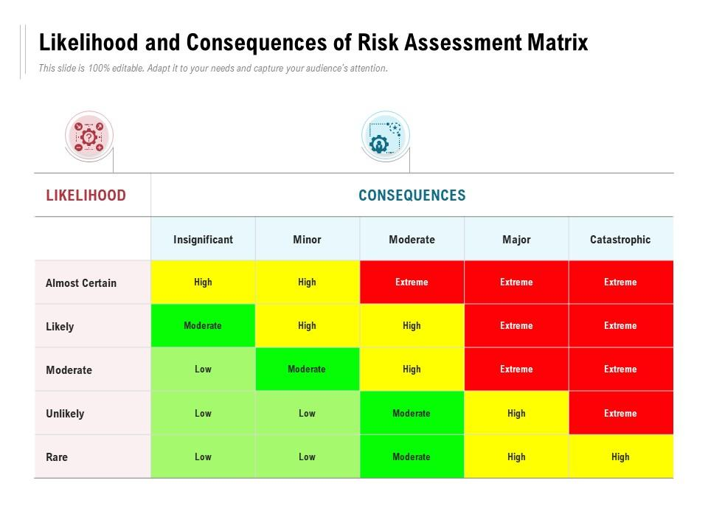
6. Risk Based Testing Strategies
Risk ID | Risk | Likelihood (1-5) | Impact (1 – 5) | Type of Testing | Risk Rating | Risk Level
1 | User is not be able register in the system | 3 | 4 | UAT Testing | 12 | High
2 | User will not be able to reach the portal home page to post or view cars | 3 | 4 | UAT Testing | 12 | High
3 | User will not be able to sell their car | 3 | 4 | UAT Testing | 12 | High
4 | User will not be able to find the car expected | 3 | 3 | UAT Testing | 9 | High
5 | User will not be able to complete their profile information | 3 | 3 | UAT Testing | 9 | High
Insert the 5x5 matrix that’s used in the risk assessment

Slide 18
6. Risk Based Testing Strategies
Risk Analysis
-Identify all potential risks. -Divide the risks into functional, technical, and nonfunctional risks. Using the risk matrix, determine the level of risk. Prioritize the extremely high risk situations.
Test planning
SDLC Model, spiral model is chosen. The test strategy and timetable are created based on the risk assessment.
Test Execution
The execution of tests is...... UAT Unit Performance Compability Portability Usability security

Slide 19
7.Qualitative and Quantitative Risk Analysis
Qualitative Risk Analysis | Quantitative Risk Analysis
Qualitative risk assessment is subjective. Using a risk assessment matrix, predict risk severity based on likelihood and impact. No numerical estimate for a fund or budget | Quantitative risk analysis is objective Include prioritized list of risk done using a risk matrix Includes reliable data such as completion Time ,schedule, budget resources and so on

Slide 20
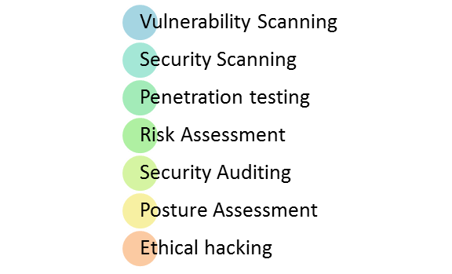
8. Security Testing
What is security testing ?
Security testing is a type of software testing that is focused on identifying vulnerabilities and weaknesses in an application or system's security measures. The objective of security testing is to ensure that the system or application is secure from potential threats such as hacking, unauthorized access, data breaches, and other cyber-attacks.
-Types of security testing
- How it is conducted- Authentication, Authorization, SQL injection.
To make sure that the system only permits authorized users to access it, authentication testing is done by attempting to get into the system using multiple sorts of credentials, such as legitimate and illegitimate usernames and passwords.
- To make sure that the system only permits authorized users to access certain resources or take certain actions, authorization testing is carried out by making an effort to access those resources or do those actions.
- To test whether the system can recognize and thwart these kinds of attacks, malicious SQL code is intentionally injected into the system.

Slide 21
9. Test plans and Test cases
Test plan : A Test Plan is a concept and deliverable that defines the strategy that will be used to verifiy that the product or system is develoved according to its specification and requirement.
Test case : Test case consist of test case name , precondition , steps / input condition , excepted result .
Functional testing
1. Unit Testing
2. Unit testing
2. Performance testing
Requiment | Test Scenario ID | Test Scenario | Number of test test Cases
Functional Testing | TS001 – Unit Testing | Validating registration functionalit | 1
Requiment | Test Scenario ID | Test Scenario | Number of test test Cases
Functional Testing | UA001 – UAT Testing | Ensure user can register in the portal | 2
Requiment | Test Scenario ID | Test Scenario | Number of test test Cases
Functional Testing | PM001 – Performance testing | Testing performance of login | 1

Slide 22
Unit testing

Slide 24
UAT Testing

Slide 25
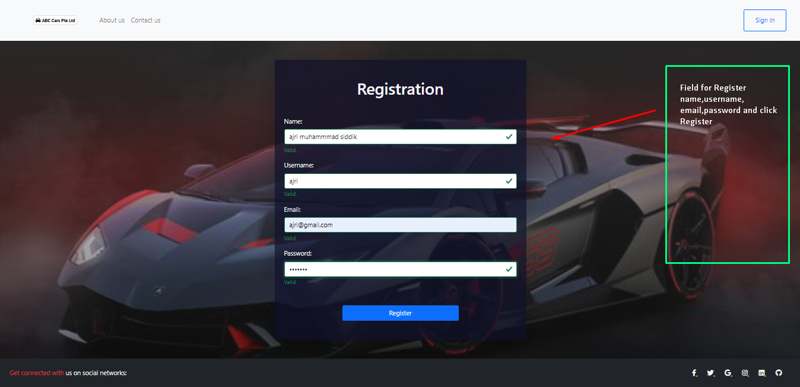
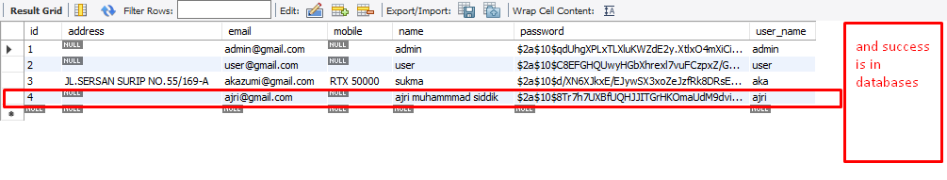
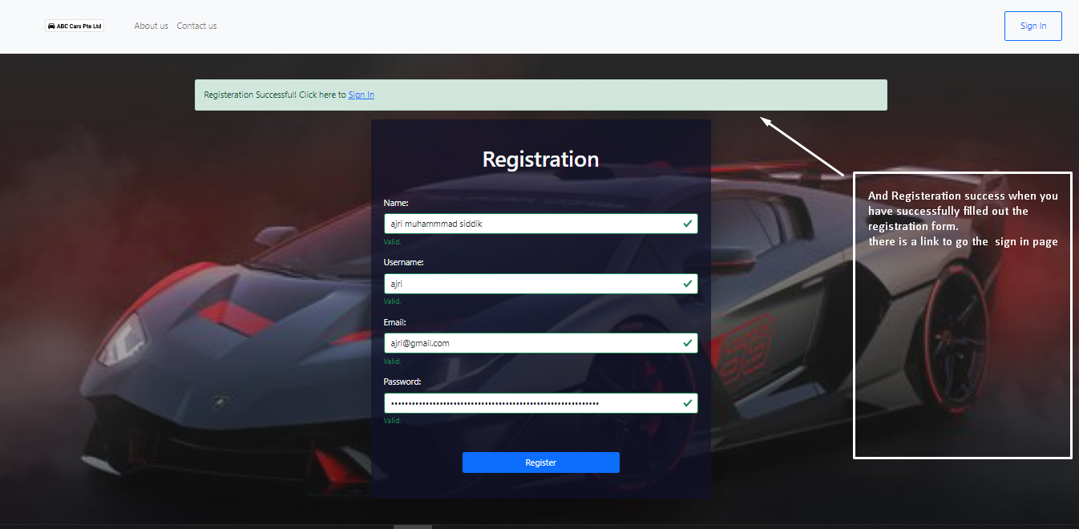

Slide 26
Performance Testing

Slide 27
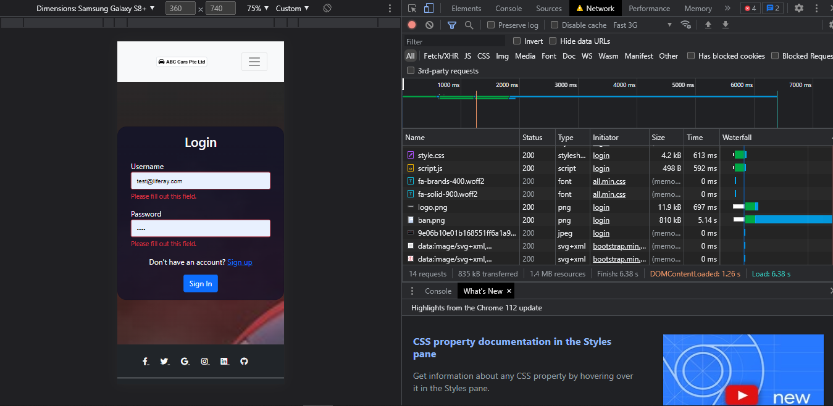


Slide 28
Used Car Sale Portal Project
Reported By: | Ajri Muhammad siddik
Report Date: | 05/05/2023
Tested By: | sukma
Tested Date: | 05/05/2
Testing Name/ Test Scenario ID | Functional testing:-UAT Testing/ TS001 / TS002 / TS003 / TS004 /TS005
Total Number of Test Cases | 5
No. of Pass: | 4
No. of Failures: | 1
Elapsed Time: | 00.30:00
Tested By: | Supriadi
Tested Date: | 06-05-2023
Testing Name/ Test Scenario ID | Functional testing:-Unit Testing/ TS006 / TS007
Total Number of Test Cases | 10
No. of Pass: | 10
No. of Failures: | 0
Elapsed Time: | 00:30.00
Tested By: | Reyhan
Tested Date: | 06-05-2023
Testing Name/ Test Scenario ID | Performance Testing/ TS006
Total Number of Test Cases | 2
No. of Pass: | 2
No. of Failures: | 0
Elapsed Time: | 00:10:00
Tested By: | AJri Muhammad siddik
Tested Date: | 06-05-2023
Testing Name/ Test Scenario ID | Compatibility Testing/ TS007 / TS008 / TS009 / TS010
Total Number of Test Cases | 15
No. of Pass: | 15
No. of Failures: | 0
Elapsed Time: | 00:40:00
Tested By: | Ajri Muhammad siddik
Tested Date: | 06-05-2023
Testing Name/ Test Scenario ID | Usability Testing / TS011
Total Number of Test Cases | 5
No. of Pass: | 4
No. of Failures: | 1
Elapsed Time: | 00:20:00
Tested By: | Ajri Muhammad siddik
Tested Date: | 06-05-2023
Testing Name/ Test Scenario ID | Security Testing/ TS012
Total Number of Test Cases | 5
No. of Pass: | 4
No. of Failures: | 1
Elapsed Time: | 00:20:00
Tested By: | Ajri Muhammad siddik
Tested Date: | 06-05-2023
Testing Name/ Test Scenario ID | Portability Testing/ TS013
Total Number of Test Cases | 3
No. of Pass: | 3
No. of Failures: | 0
Elapsed Time:
SUMMARY LOG STATUS
Total Number of Test Cases | 45
Total Number of Pass | 42
Total Number of Failures | 3
Pass % | 91%
Total Elapsed Time | 06:00:00

Slide 29
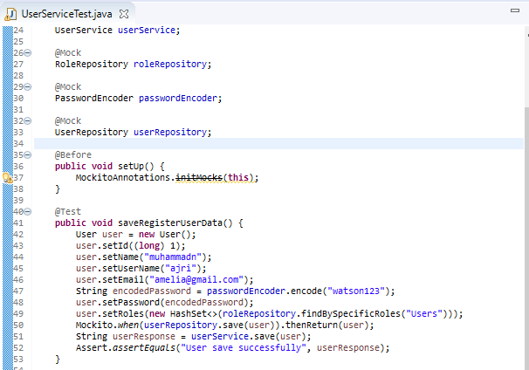
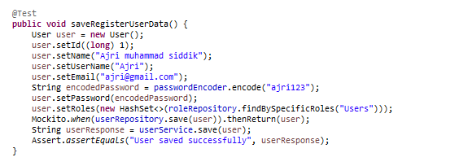
11.Modification of fail test cases
Modification to source code for unit testing failed cases
Before modification
After modification

Slide 30
Re testing for unit testing test case
Test Scenario ID | Test Case ID | Test Case | Pre-condition | Expected Result | Actual Result | Pass/ Fail
TS001 | TC001 | Check if registered data can be saved | ABC Cars Portal website has completed and uploaded on server | After checking, junit should return a passing result as user data can be save | as expected | pass
Test Step & Test data | Name= Ajri Muhammad siddik Username = ajri Email= ajri@gmail.com Password= ajri123

Slide 31
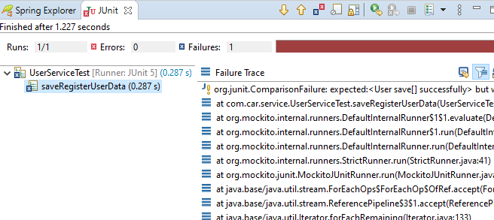
Before modification

Slide 32
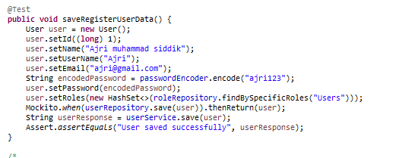
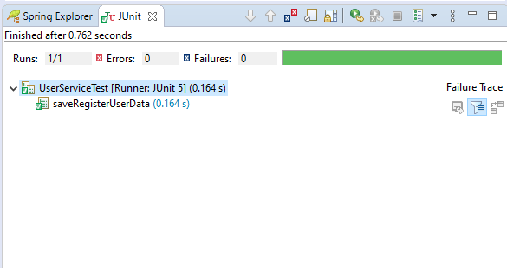
After modification

Slide 33
11.Modification of fail test cases
Log Result after modification

Slide 34
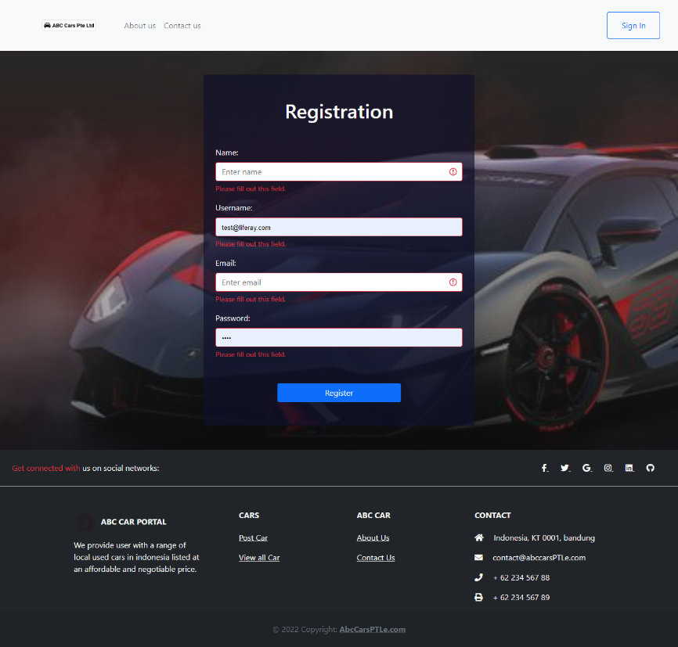
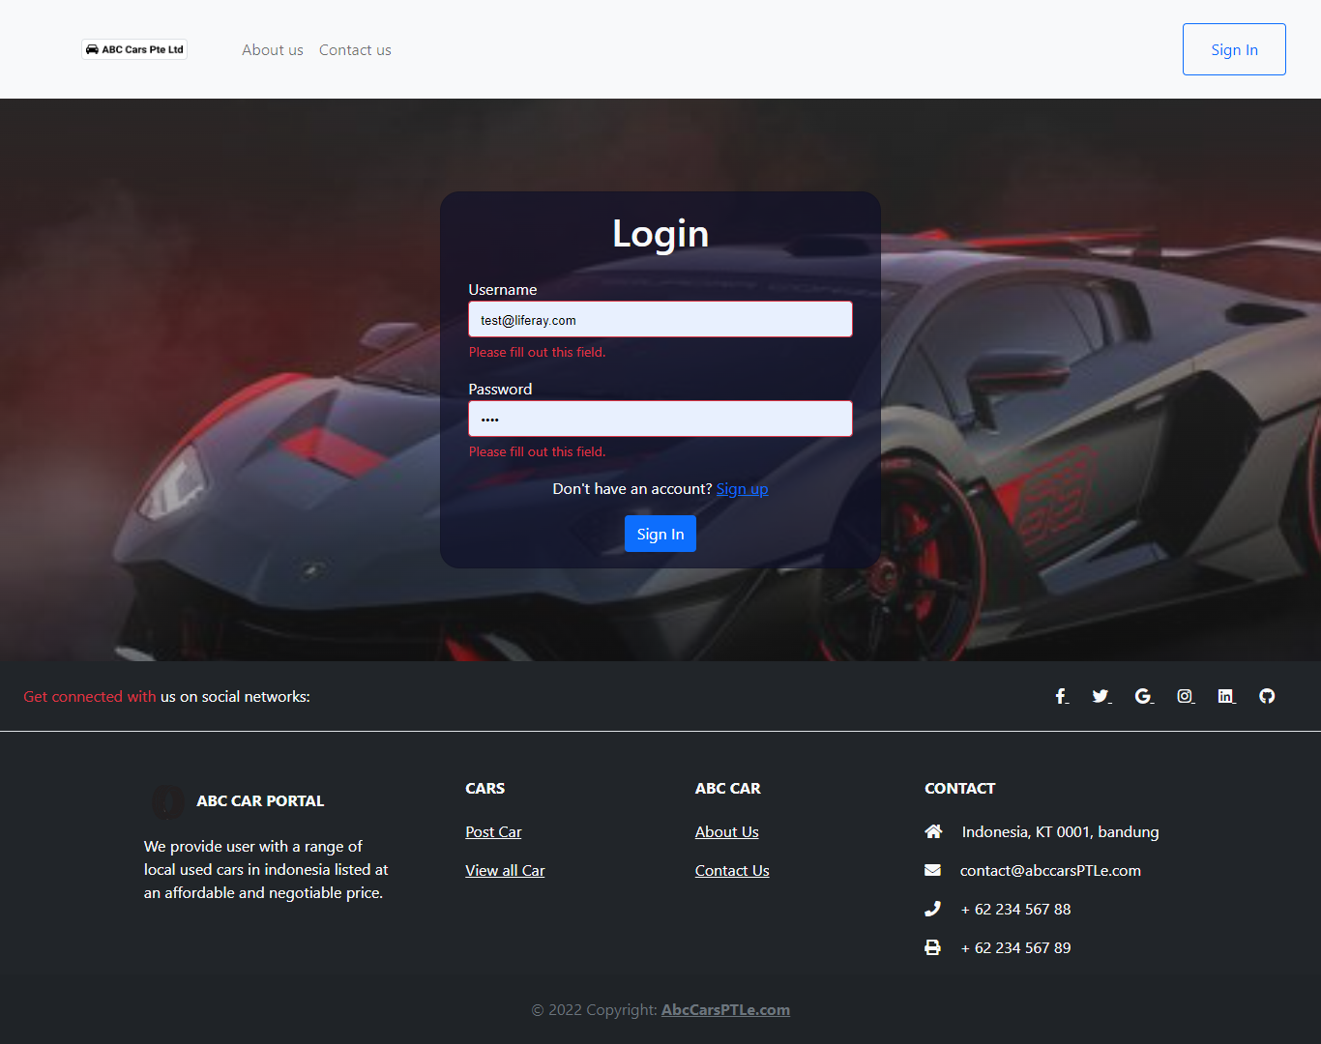
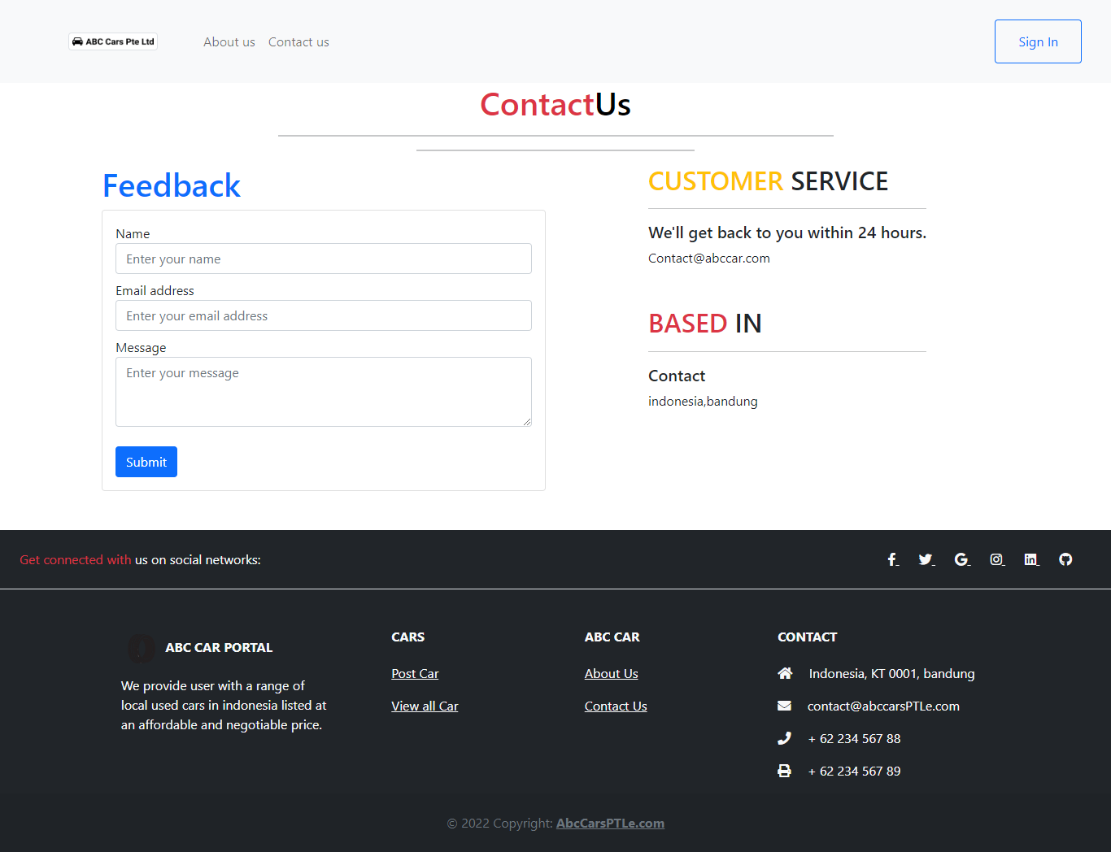
13. Project Results
Provide Screen Capture of Developed Pages

Slide 35
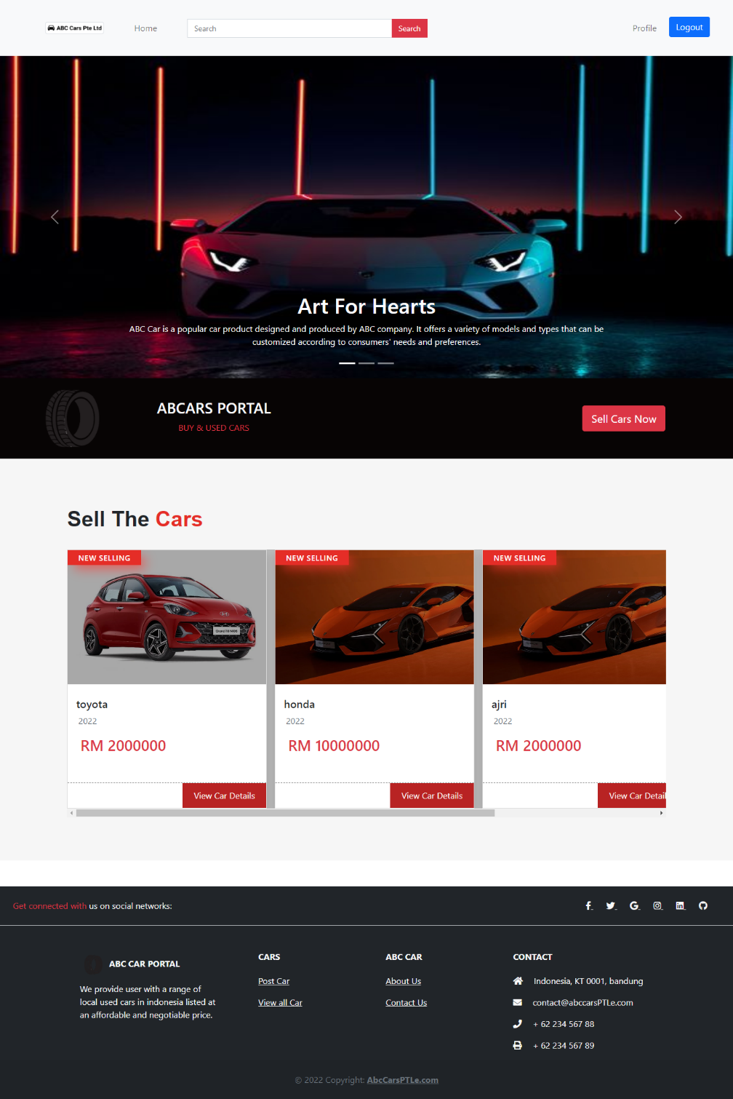
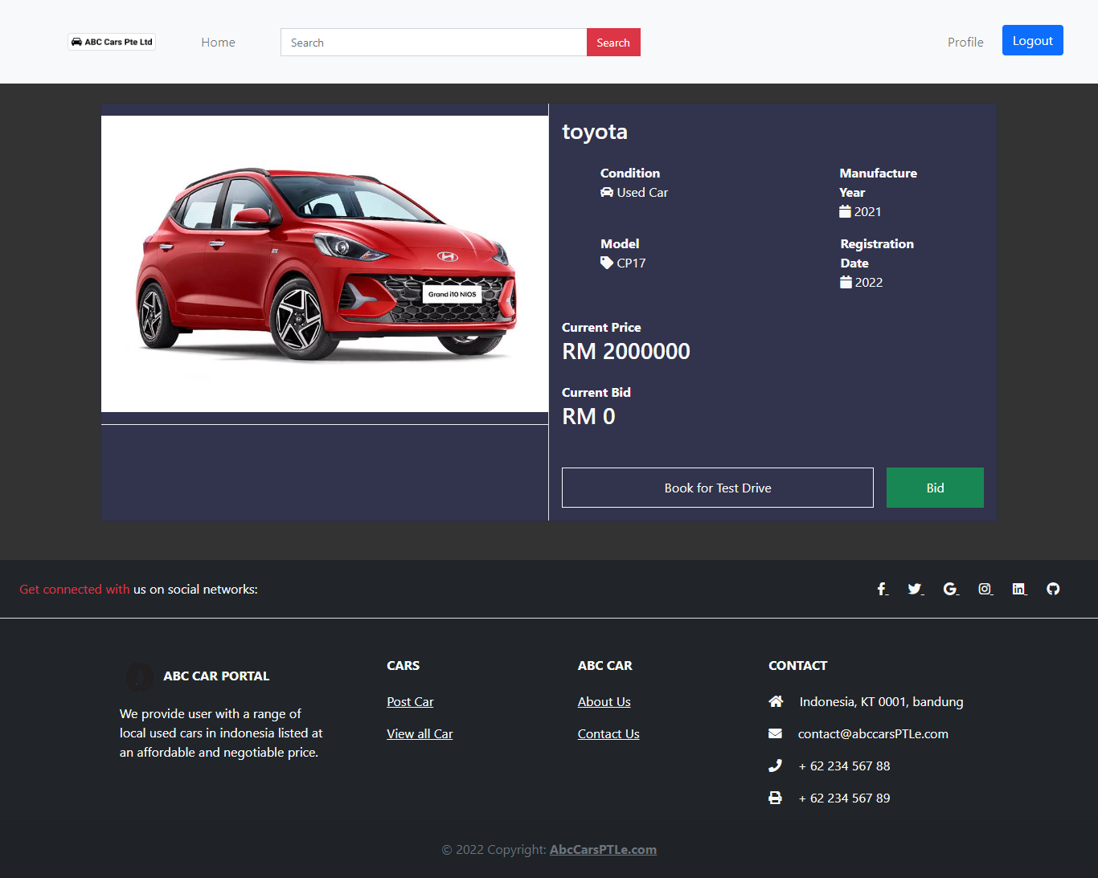

Slide 36
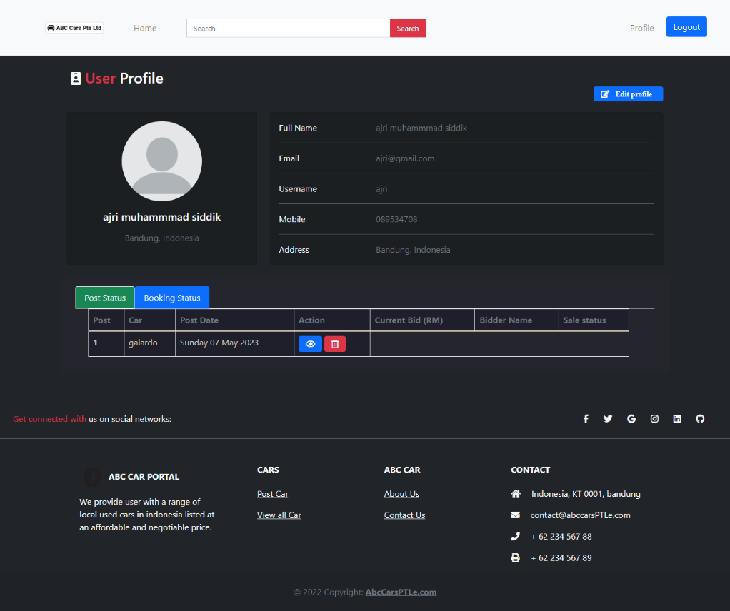
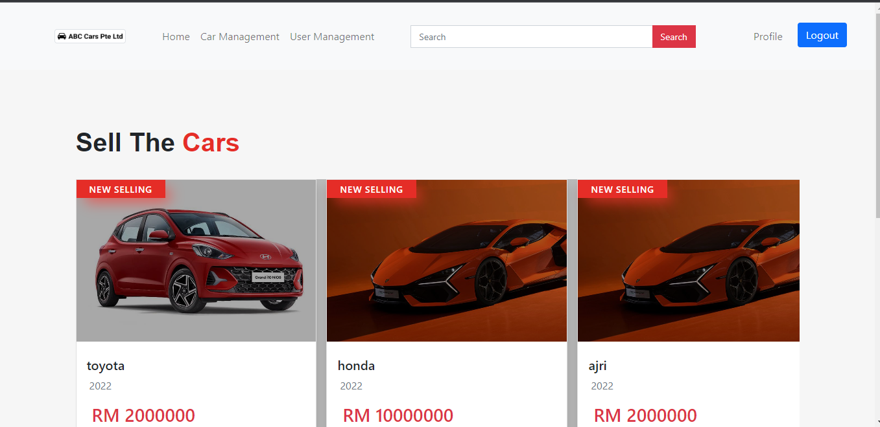

Slide 37
